Slide 1

Project1 presentation
Group18
LAN Bo, SHEN Ye, SHUM Ka Shun, YU Yiduo

Slide 2
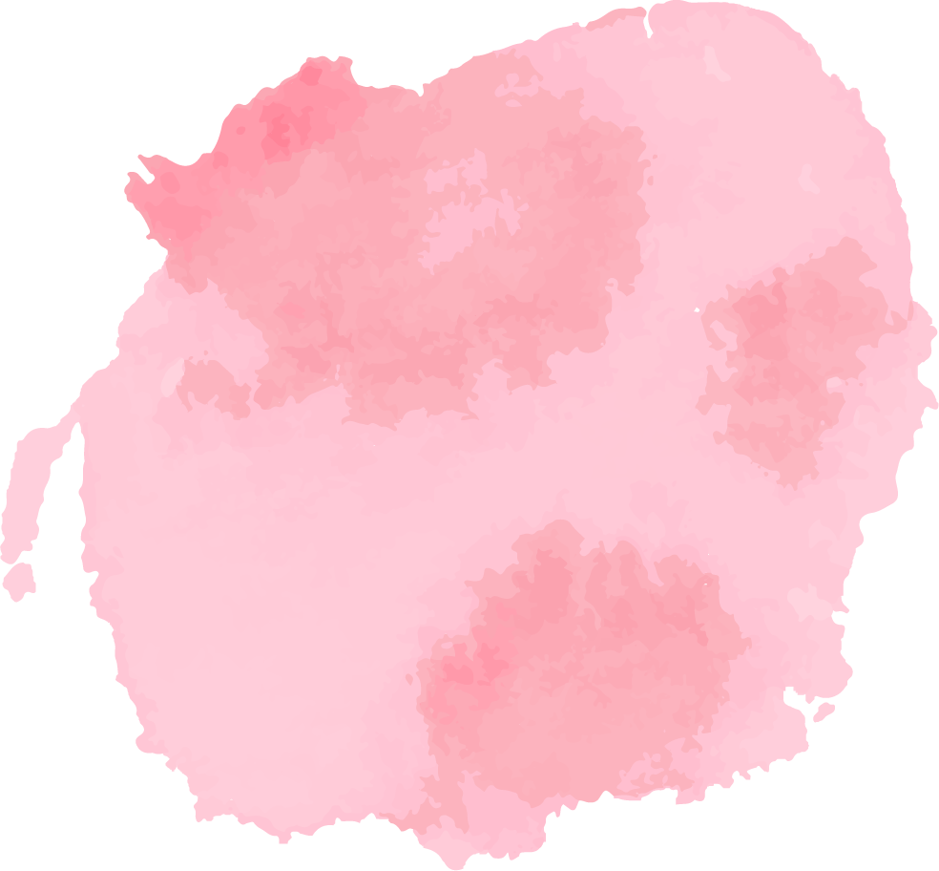
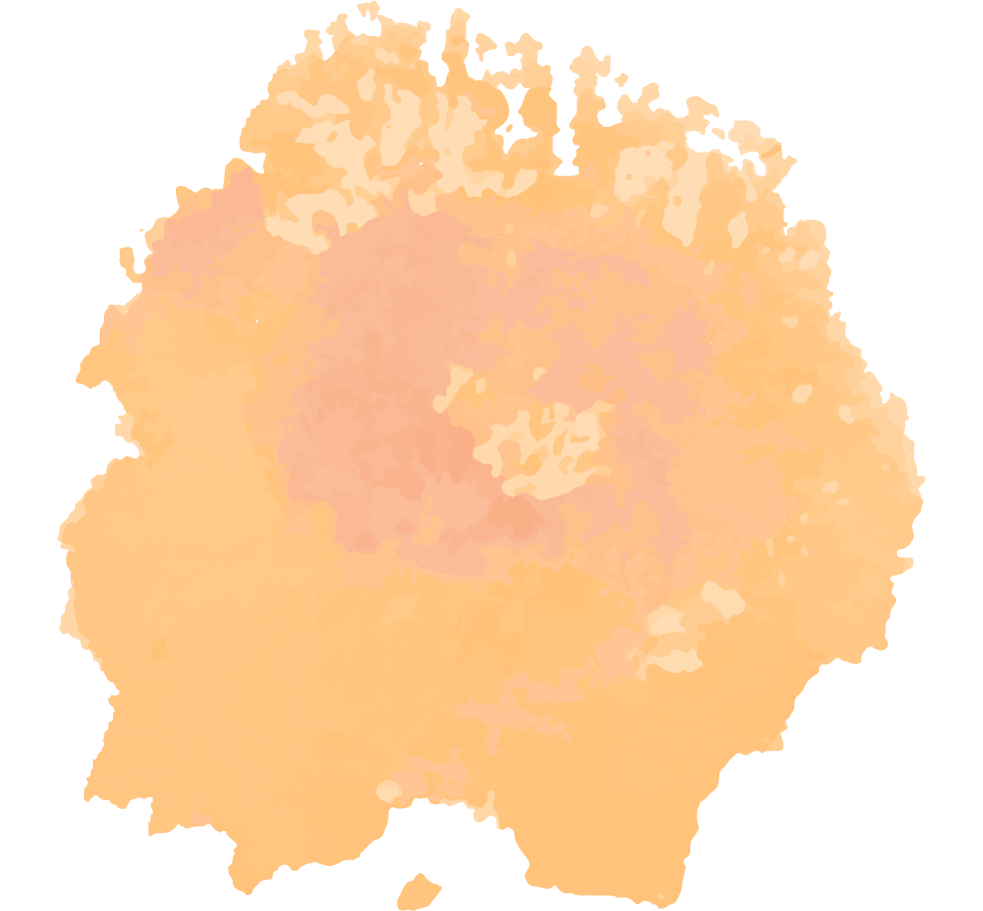
Table of Contents
01
03
02
04
The Background
Reflections
Here you could find the background information
Our discoveries about the project while fine-tuning.
CNN model
Final model
The procedure to come up with baseline1&2 CNN model.
Our transfer-learning model based on resnet18.

Slide 3

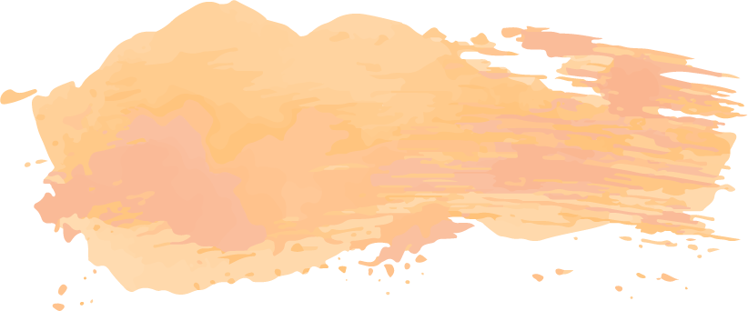
01
Background

Slide 4
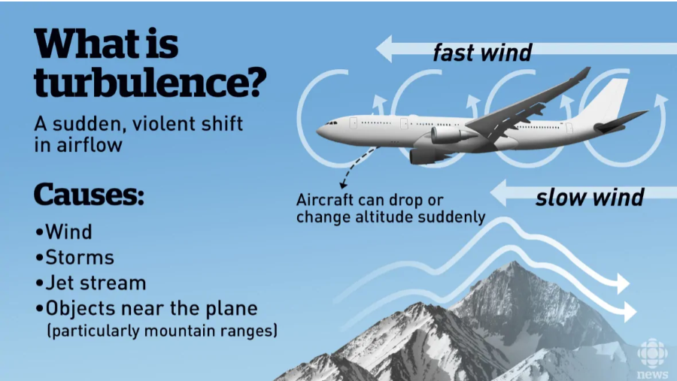
Background for project1
In fluid dynamics, turbulence or turbulent flow is fluid motion characterized by chaotic changes in pressure and flow velocity.

Slide 5
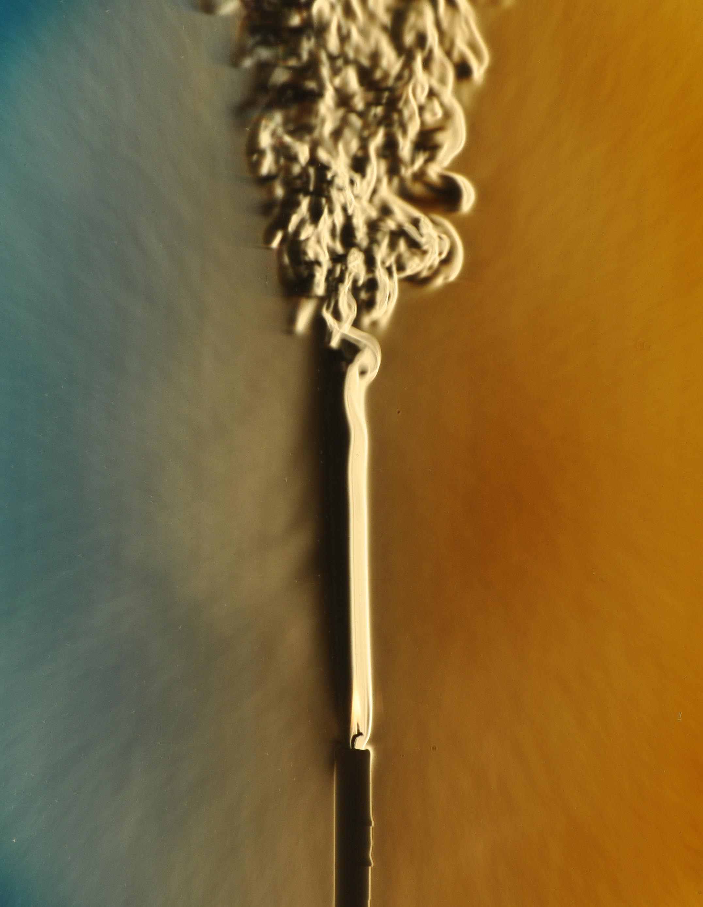
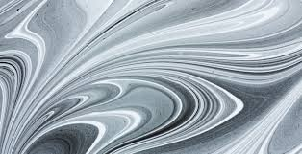

Slide 6

Three classes
NIL
MOD
SEV
Do not contain turbulence
Small intensity
High intensity

Slide 7
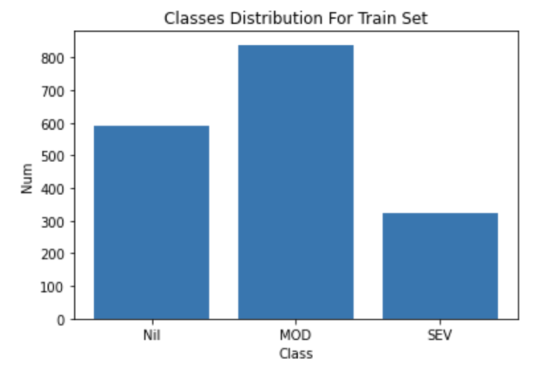
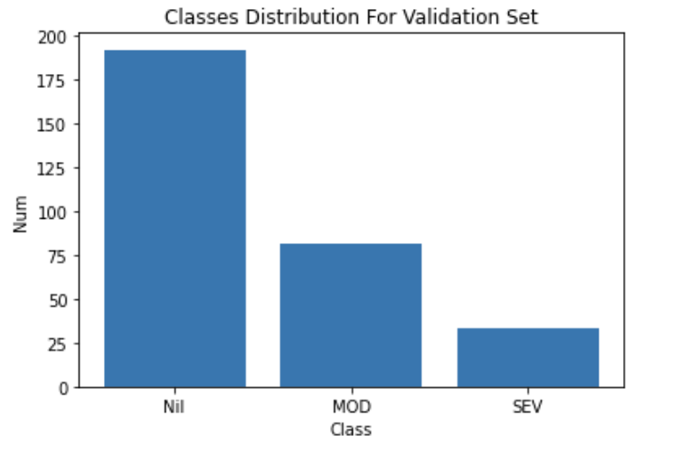
View Classes Distribution
Train Set
Validation Set
839
192
591
324
81
33
Imbalanced

Slide 8
02
CNN model

Slide 9

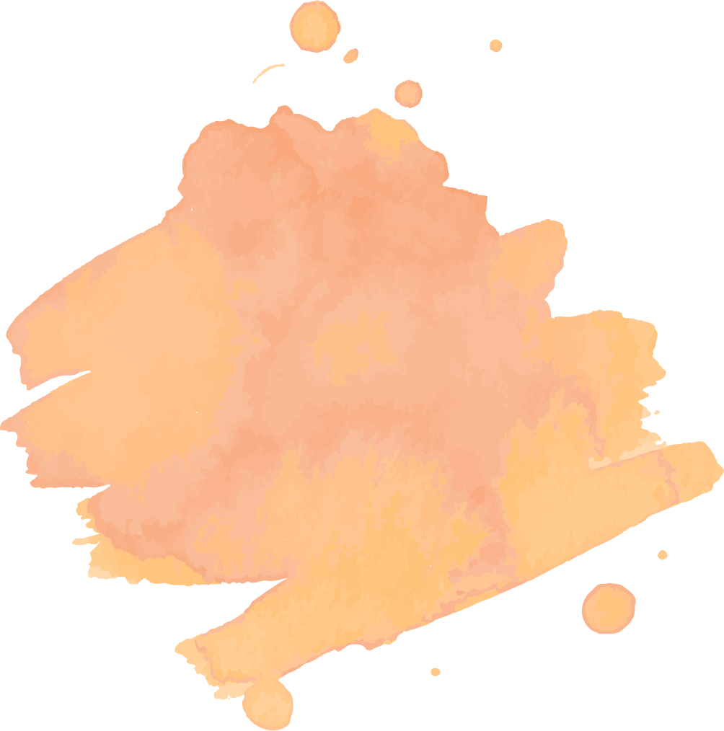
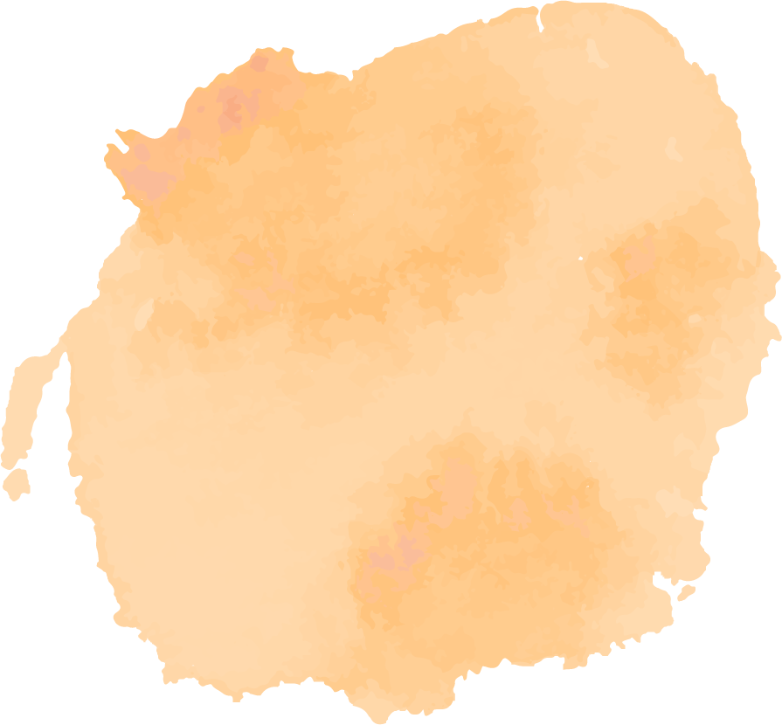
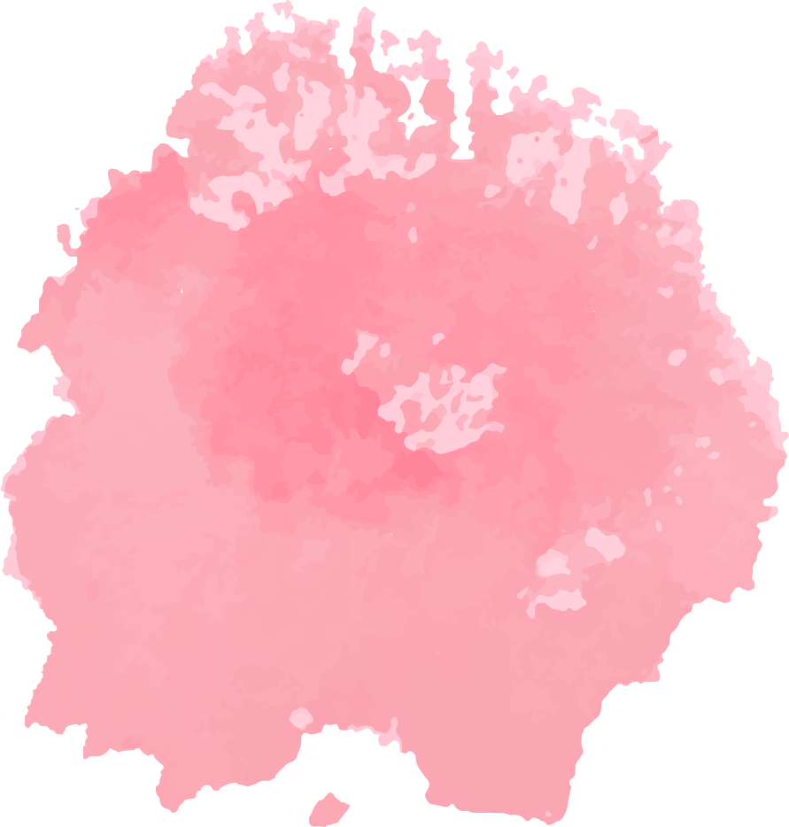
Develop Timeline
2-layer CNN with 2 layer fc
01
02
03
04

Slide 10
Accuracy is only 55%!
Make it simpler
Make it more complicated

Slide 11
Develop Timeline
2-layer CNN with 2 layer fc
01
02
03
04
Reduce parameters

Slide 12

Key Action
Kernel
Pointwise CNN
Larger kernel size and stride
Might not related to reduce params.
More CNN layer
result
So more maxpool layer and reduce the fc layer input
3-layer CNN and fc with less parameters

Slide 13
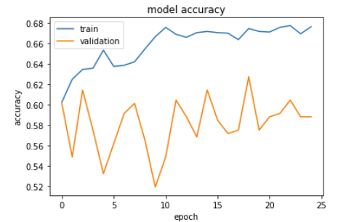
Accuracy Charts
Validation score goes up and down!

Slide 14
Develop Timeline
2-layer CNN with 2 layer fc
Add lr-scheduler and bn layer
01
02
03
04
Reduce parameters

Slide 15
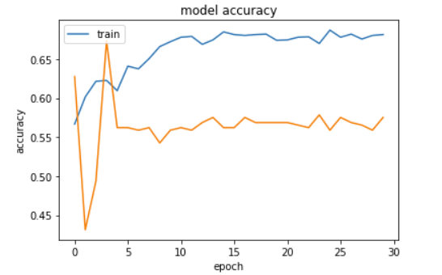
Accuracy Charts
Lr + batch norm

Slide 16
Develop Timeline
2-layer CNN with 2 layer fc
Add lr-scheduler and bn layer
01
02
03
04
Make model more complicated
Reduce parameters

Slide 17
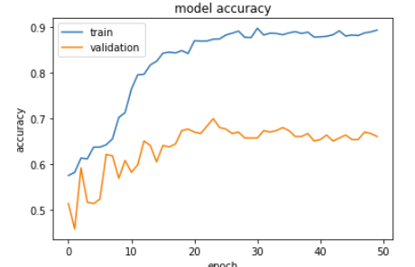
Accuracy Charts
3CNN + 3FC

Slide 18
03
Reflections

Slide 19
Overnormalize?

Slide 20
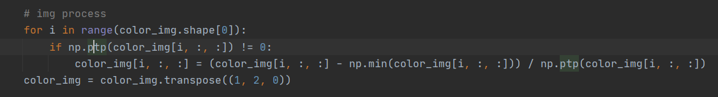
Peek into dataset
tensor([[0.1725, 0.1725, 0.1725, ..., 0.9725, 0.9725, 0.9725], [0.1725, 0.1725, 0.1725, ..., 0.7765, 0.7765, 0.7765], [0.1725, 0.1725, 0.1725, ..., 0.3608, 0.7765, 0.7765], ..., [0.0314, 0.8902, 0.8902, ..., 0.3059, 0.3059, 0.4824], [0.0314, 0.0314, 0.0314, ..., 0.9569, 0.9569, 0.3059], [0.0314, 0.0314, 0.0314, ..., 0.9569, 0.9569, 0.3059]])

Slide 21
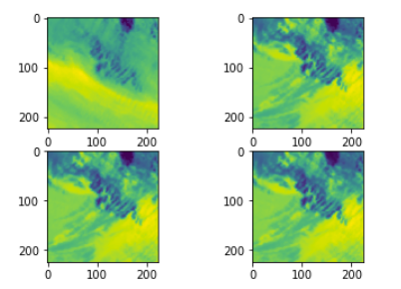
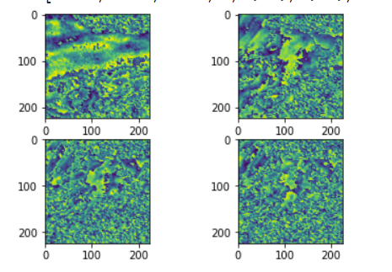
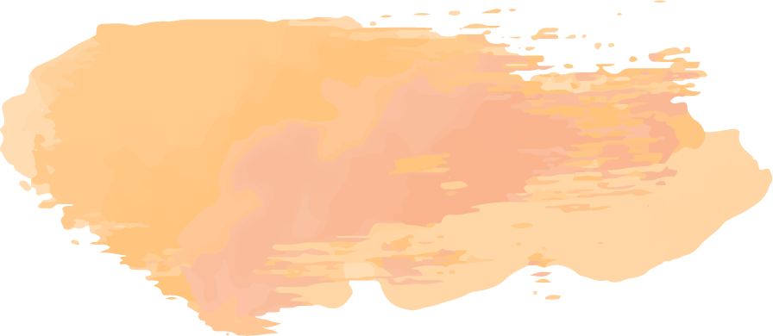
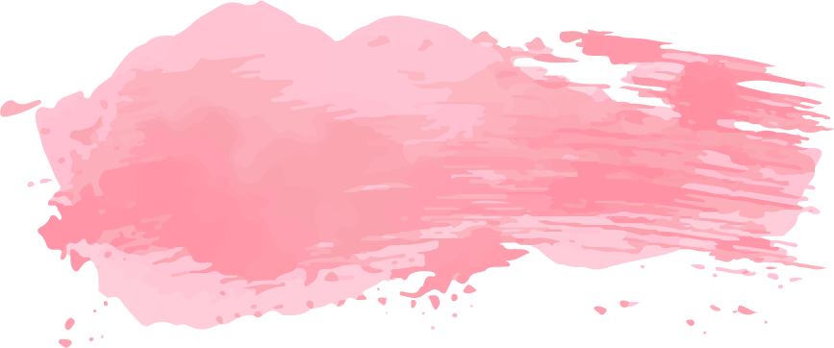
Peek into dataset

Slide 22
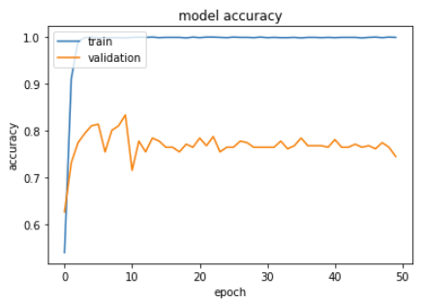
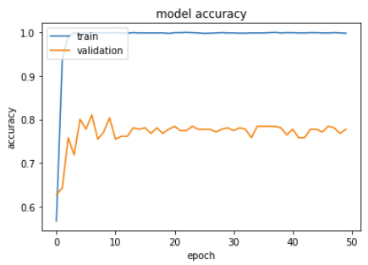
Accuracy Charts
3CNN + FC without LDAM
3CNN + FC with LDAM

Slide 23
Data-augmentation?

Slide 24
Accuracy Charts

Slide 25
—Our discovery
“The color and direction may matter for detecting and analyzing turbulance.”

Slide 26
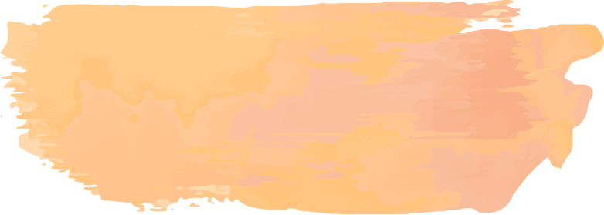
77%
Baseine1&2 results

Slide 27
04
Final model

Slide 28
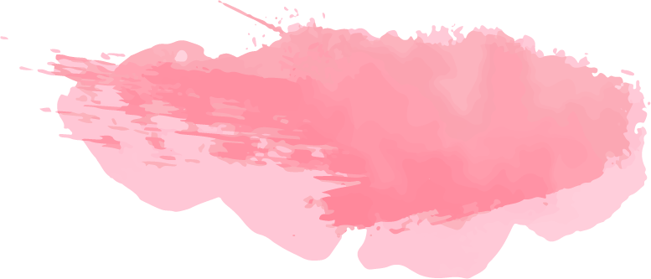
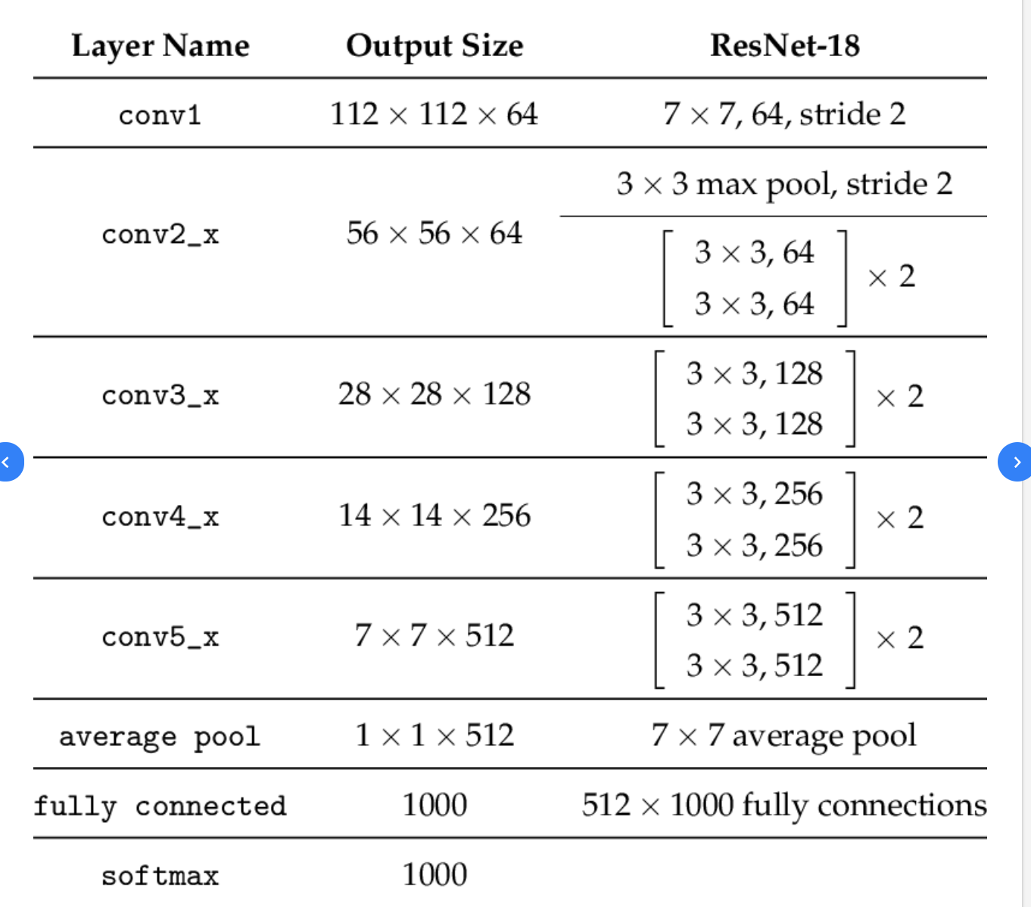
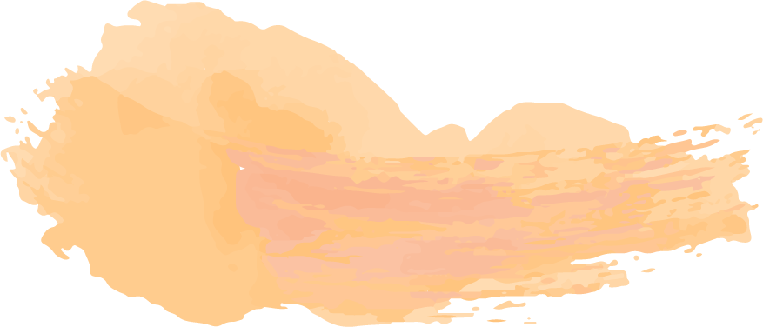
RESNET-18
NIL
4-channels Image
MOD
the middle of our network is famous pretrained Resnet-18, we use it as feature extractor and we change the output of last fully-connected layer to 3 (Nil, MOD, SEV) and we modify the first convolution input layer to accept 4 channels.
SEV

Slide 29
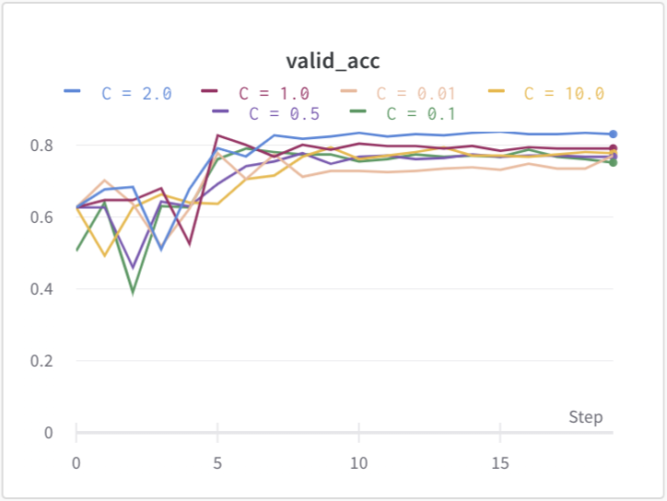
Tuning Parameter
We list the average validation set accuracy of different hyper-parameter C.
By Comparing all these parameters, we find C = 2.0 the best.

Slide 30
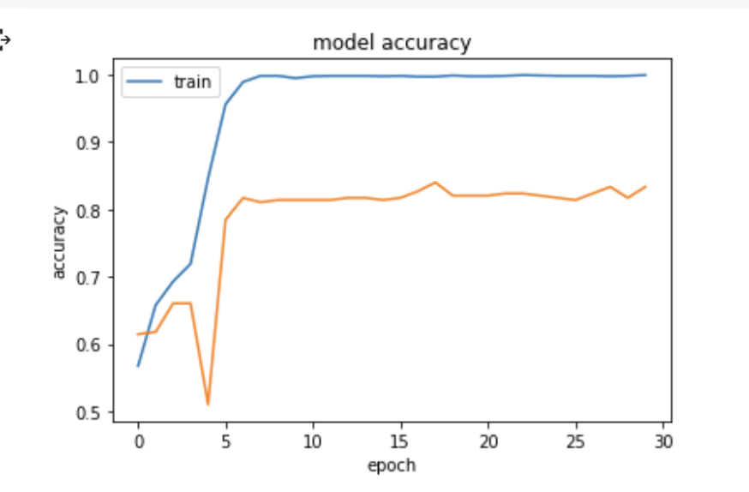
Final Model Performance
Training Accuracy
99.83%
Precision
99.8%
Recall
100%
NIL
F1
99.9%
Precision
99.9%
Recall
99.8%
F1
99.9%
MOD
Precision
99.7%
Recall
99.7%
F1
99.7%
SEV

Slide 31
Final Model Performance
ValidationAccuracy
83%
Precision
94%
Recall
85%
NIL
F1
89%
Precision
68%
Recall
85%
F1
75%
MOD
Precision
66%
Recall
64%
F1
65%
SEV

Slide 32
Thanks!
Do you have any questions?

